Slide 1
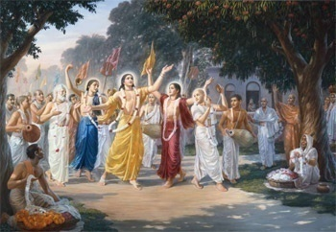
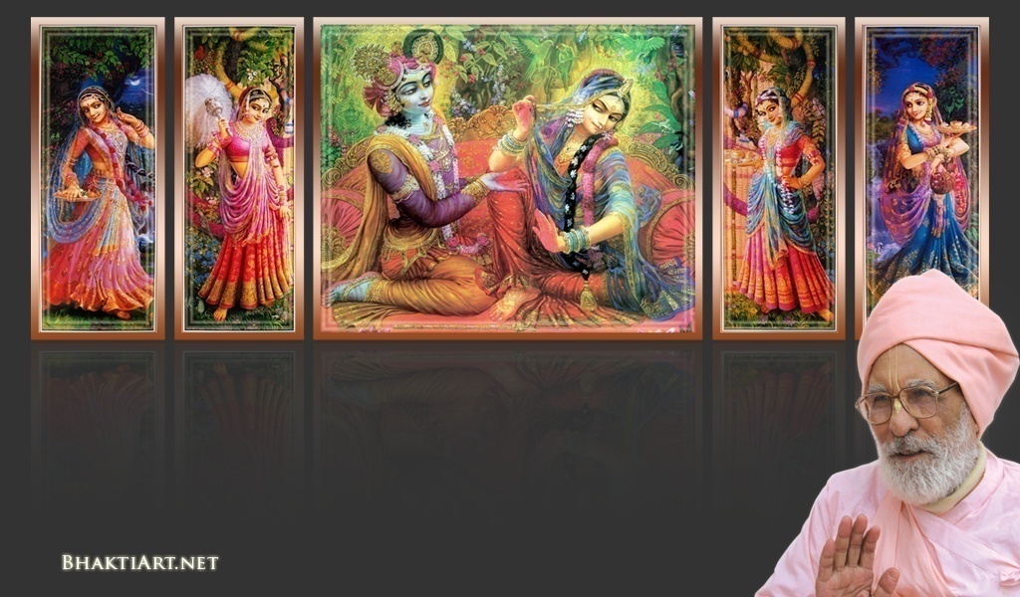
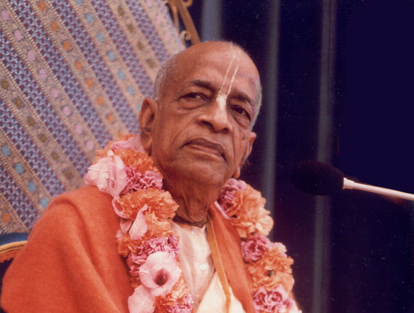
Sri Krsna Caitanya Prabhu Nityananda
Sri Advaita Gadadara Srivasadi
Gaura Bhakta Vrinda
Week 350
Jul 17
2015
Hare Krsna Hare Krsna
Krsna Krsna Hare Hare
Hare Rama Hare Rama
Rama Rama Hare Hare
Gokul Bhajan & Vedic Studies
North Carolina, USA
Notes:
Om Ajnana timirandhasya, jnananjana salakaya
Caksur unmimiltam yena, tasmai sri gurave namah
Namah om vishnu padaya, radhikayah priyatmane
Sri-srimad bhaktivedanta, narayana iti namine
Narayanam gurum vande, Saranam bhakta baandhavam
Gaura manobhishtam purnam, Radha daasyam pradaayakam
Rupaanugaacarya varyam, Rupa manjari preshtakam
Patita paavana baandhava, Yugaacarya naaraayanam
Sri krishna lila kathane sudaksham, Audarya-madhurya gunais ca yuktam
Varam varenyam purusham mahantam, Narayanam tvam sirasa namami
He krishna karuna sindho, dina bandho jagat pate
Gopesha gopika kanta, radha kanta namo ‘stu te
Tapta kancana gaurangi, radhe vrindavaneshvari
vrsabhanu sute devi, pranamami hari priye
bhajami radham aravinda netram, smarami radham madhurasmi-tasyam
vadami radham karuna bharardram, tato mam anyasti gatir na kapi
bhaktya vihina aparadha-laksaih, ksiptas ca kamadi-taranga-madhye krpamayi tvam saranam prapanna, vrnde namas te caranaravindam
--------------------------
First of all, I pay my koti dandavat pranams to my diksha guru Om vishnupada rupanuga acharya Sri Sri Bhakti Vedanta Narayana Goswami maharaja. My koti dandavat pranams to Sri Sri Bhakti Vedanta Swami Prabhupada, and guru varga.
My humble pranams at the lotus feet of all assembled devotees, vaishnavas and vaishnavis..

Slide 2
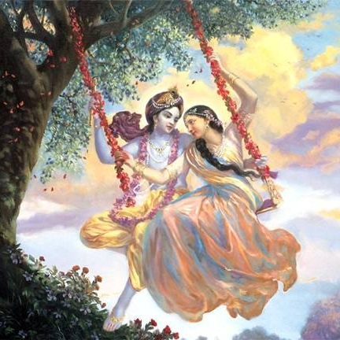
Jaya Rādha Mādhava
Jaya Kunja Vihārī
Jaya Gopī Jana Vallabha
Jaya Giri Vara Dhārī ... (Jaya)
Yaśodā Nandana Vraja Jana Ranjana
Yamunā tīra Vana Cāri ... (Jaya)
[ Hare Krishna Hare Krishna
Krishna Krishna Hare Hare
Hare Rāma Hare Rāma
Rāma Rāma Hare Hare ]

Slide 3
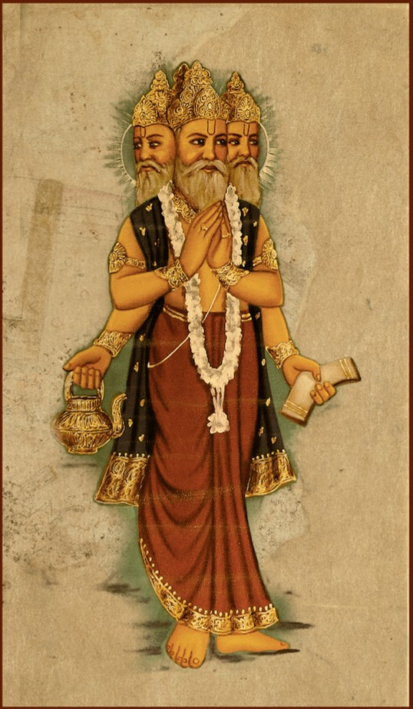
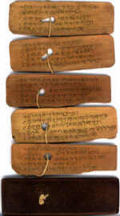
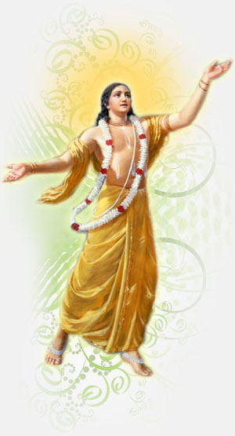
Slides Video
Brahma Samhita

Slide 4
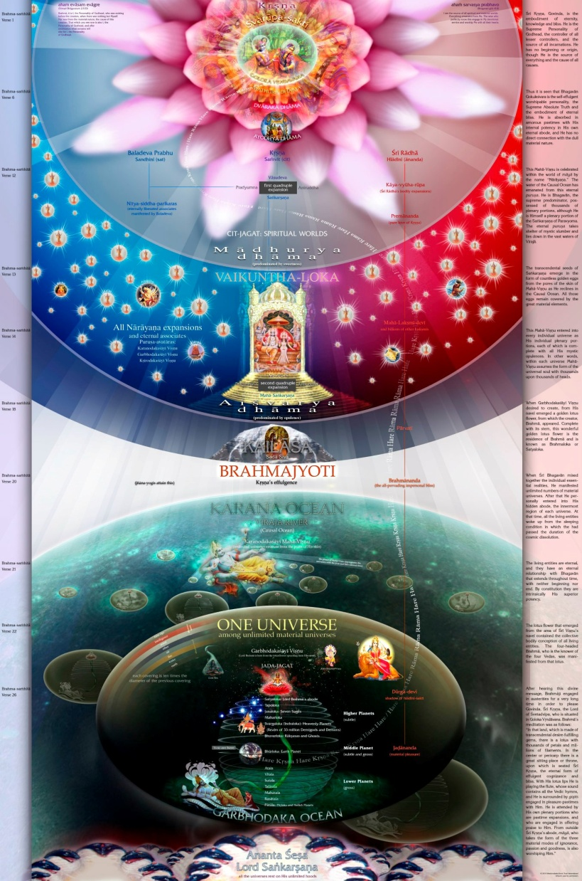
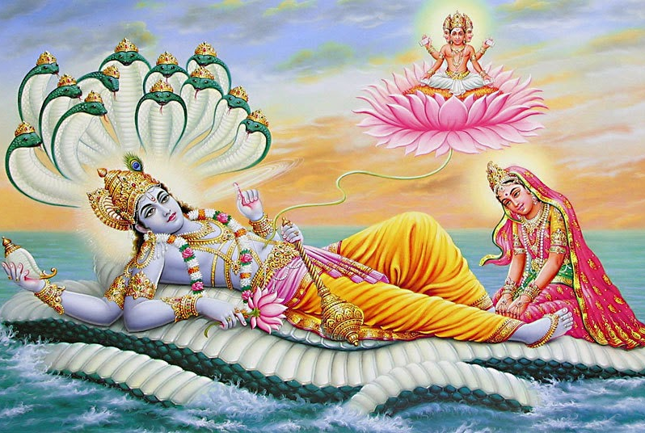
Sri Brahma Samita:
The Origin

Slide 5
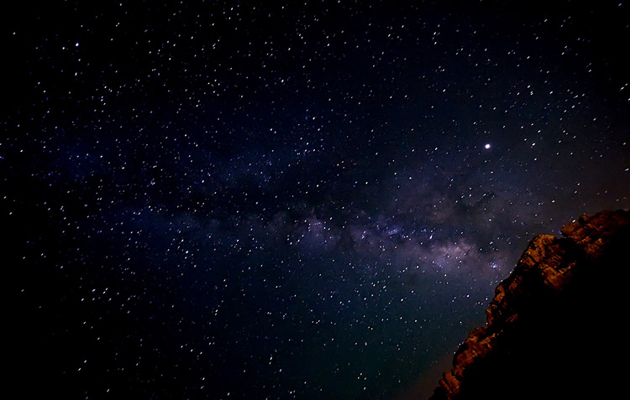
Notes:
Wonder about our world and beyond?
Scientists try to find... But seems no end!
But beyond this material universes, there are other dimensions that we cannot perceive..

Slide 6
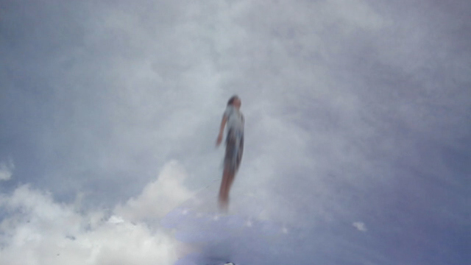
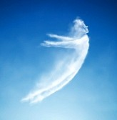
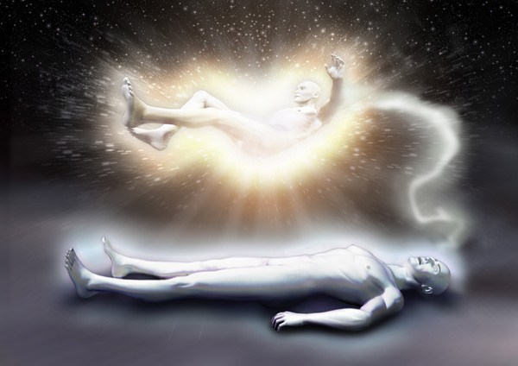
Notes:
When we leave the body, we see many dimensions!!!

Slide 7
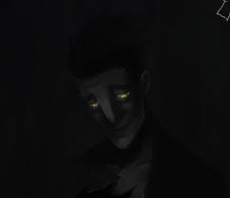
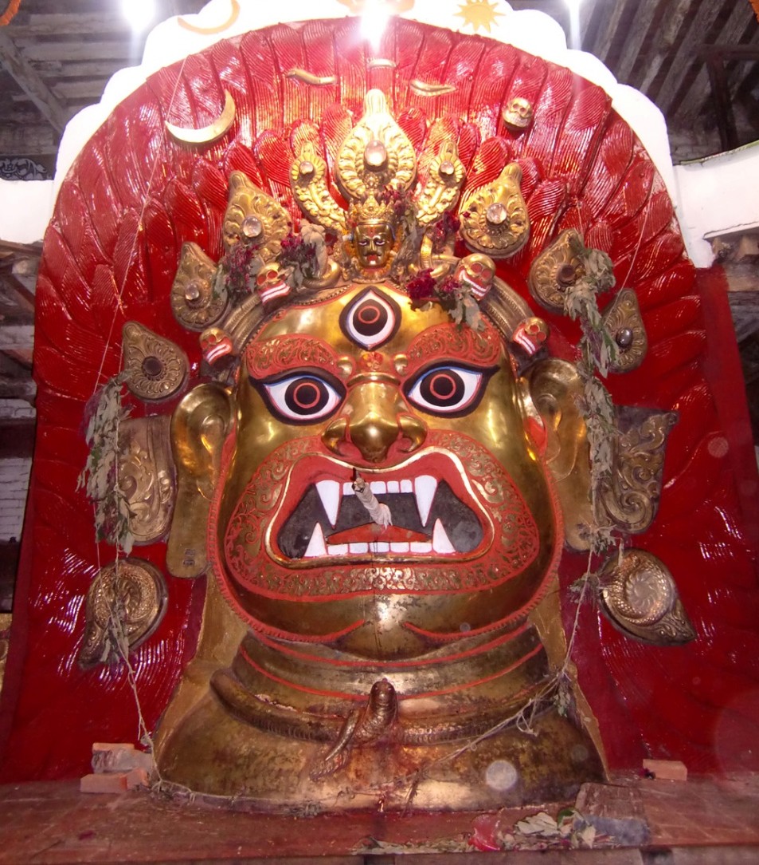
Notes:
If you keep on traveling, and going beyond material world, we will see:
Only pich dark
There you will see Akala Maha Bhairava! – one of the RUDRAS!
But when you come out by piercing the Brahmanda – the material sheath....

Slide 8
Notes:
Different Brahmandas will have different kinds of Rudras..
But what do you see when you come out of the Brahmanda?
Drakness.... RUDRA...
Then You will pierce the VRAJA RIVER

Slide 9
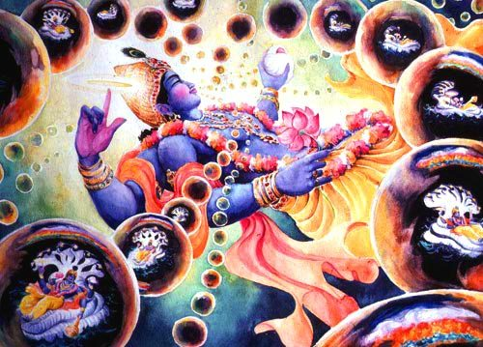
Notes:
You will see many many brahmandas..
Each Brahmanda is like a bubble..
Breathed out by Maha Vishnu.., who is an expansion of Lord Sri Krishna..
He breaths in and breaths our Brahmandas thru His unlimited pores of His body hairs..
When He breathes out, millions of Brahmandas are born
When He breathes in, all the Brahmandas go inside Him!

Slide 10
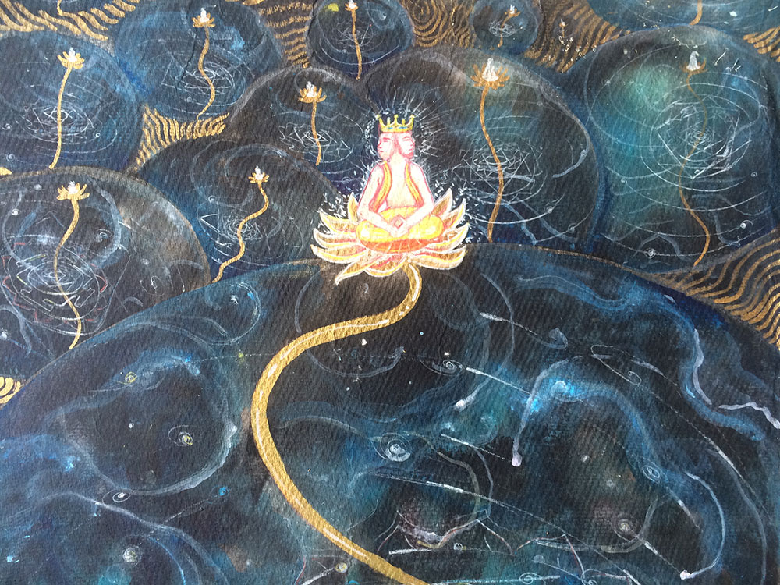
Notes:
In one of His breathed out Brahmanda is where we belong, headed by Lord Brahma.
From the navel of Lord Vishnu, Brahma came ...
This applies to every Brahmanda!
There are 14 planetary systems arranged in 7 planes.

Slide 11
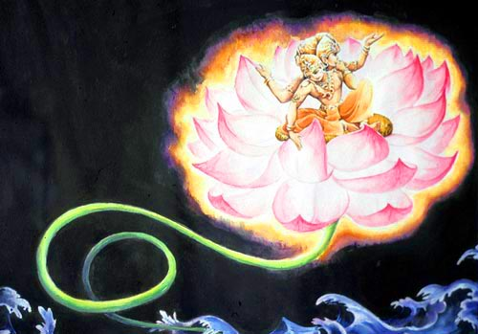
Notes:
When Brahma is manifested, there was no one else!
How will you feel if in this entire planet, you are the only one born from nowhere?
Scary?
Will you try finding out who else is around? Or, where did you come from?
He was perplexed..
Also found His goldren lotus seat was wet..
Seen a stem going down..
Traversed for many many years, but could not find the root as where it is coming from!

Slide 12
Notes:
Then Brahma heard a flute sound?
From whom do you think it is from?
Yes, from Krishna.
First the sound ‘TA PA’ came.. TAPA, TAPA, TAPA.
Krishna within the heart of Brahma instructed Him to meditate.
So, Brahma was meditating for a long time..
Then Krishna’s flute sound came again!.
He gave the GOPALA MANTRA thru SARASVATI
The He gave the KAMA GAYATRI.
Then by the flute, Krishna then gave the whole knowledge of creation to Lord Brahma.

Slide 13
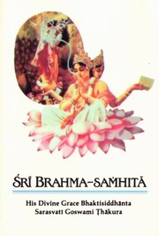
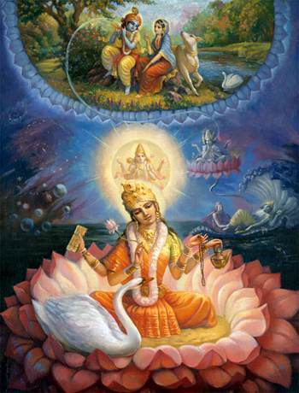
Notes:
Lord Brahma was offering beautiful prayers to Lord Krishna!
That is the Brahma Samhita
The original Brahma Samhita got 100 chapters.
What we have got is only the FIFTH chapter.

Slide 14
Brahma Samhita
Notes:
“When the Lord saw the Adi-kesava temple, He was immediately overwhelmed with ecstasy. Offering various obeisances and prayers, He chanted and danced.
“All the people there were greatly astonished to see the ecstatic pastimes of Sri Caitanya Mahaprabhu. They all received the Lord very well.
“In the temple of Adi-kesava, Sri Caitanya Mahaprabhu discussed spiritual matters among highly advanced devotees. While there, He found a chapter of the Brahma-samhita.
“Sri Caitanya Mahaprabhu was greatly happy to find a chapter of that scripture, and symptoms of ecstatic transformation — trembling, tears, perspiration, trance and jubilation — were manifest in His body.
“There is no scripture equal to the Brahma-samhita as far as the final spiritual conclusion is concerned. Indeed, that scripture is the supreme revelation of the glories of Lord Govinda, for it reveals the topmost knowledge about Him. Since all conclusions are briefly presented in the Brahma-samhita, it is essential among all the Vaisnava literatures.
“Sri Caitanya Mahaprabhu copied the Brahma-samhita, and then with great pleasure He went to a place known as Ananta Padmanabha.”

Slide 15
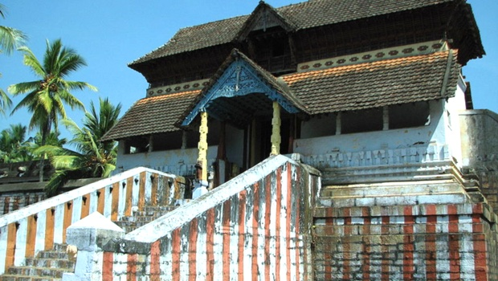
Notes:
Adi keshava temple – Thiruvattaar – Tamil Nadu
One of the 108 Divya Desams of Sri Parampara.
The temple is surrounded on three sides by rivers Kothai, Parali and Tamraparni. River Paraliyar takes a turn in this place and diverges to flow forming an island and it is called vattaru and when the temple of Adikeshav Perumaal was created it came to be known as Thriuvattaru

Slide 16
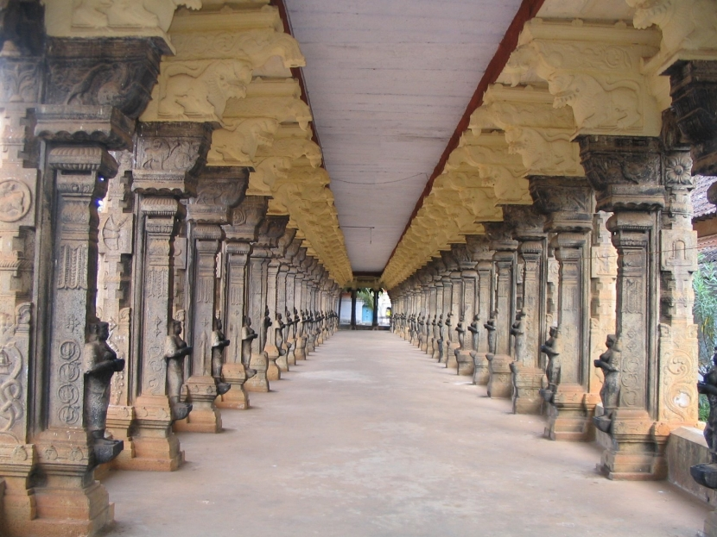

Slide 17
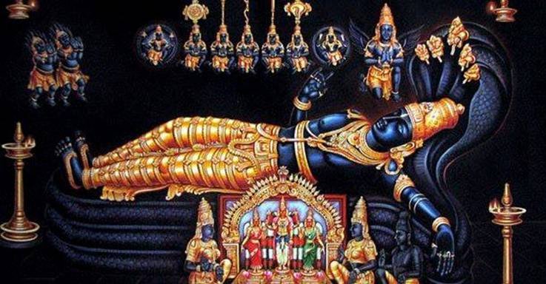

Slide 18
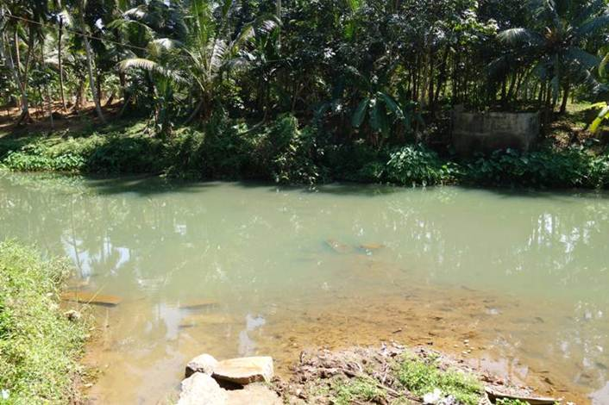
Notes:
This is the Thiruvattaar river where Lord Caitanya took bath..

Slide 19
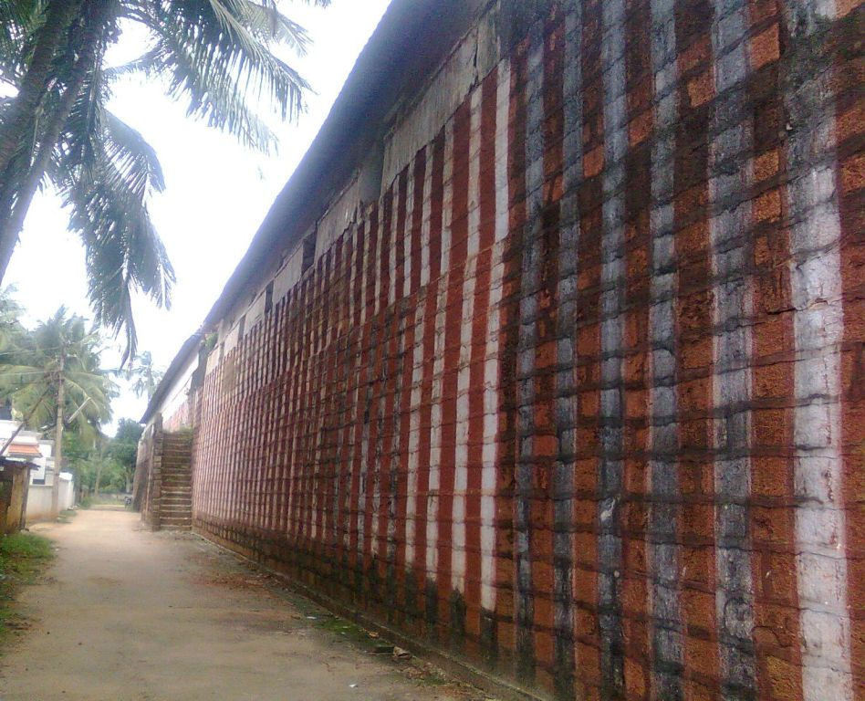
Notes:
We have got only the 5th Chapter – out of 100 chapters

Slide 20
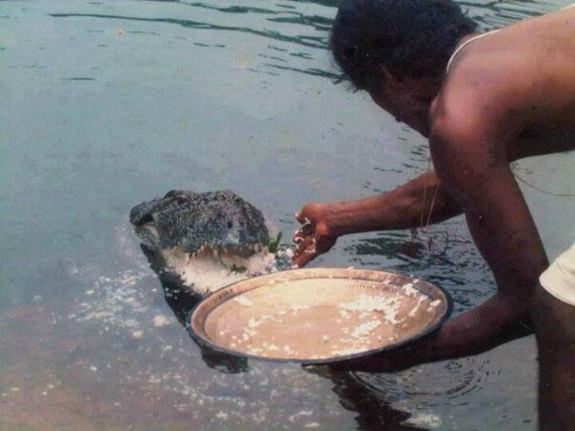
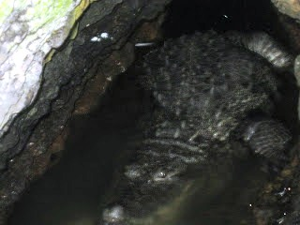
Notes:
The legend goes that while the great mystic and devotee of Lord Vishnu Sree Vilvamangalathu Swami was doing penance, Lord Krishna in the form of a little boy kept disturbing his prayers. Irked by the behaviour of the child, the saint pushed Lord Krishna aside with his left hand. It was only after the boy disappeared into a nearby cave that the truth dawned on the saint. The crevice into which Krishna is said to have disappeared is still there. The crocodile guards the entrance and the shrine. - See more at: http://www.featurewings.com/details.php?id=miracle-in-temple-vegetarian-crocodile-is-local-gu#sthash.sGtNhBM6.dpuf

Slide 21
Sri Brahma Samita:
Verse-01

Slide 22
BS - 01
īśvaraḥ paramaḥ kṛṣṇaḥ
sac-cid-ānanda-vigrahaḥ
anādir ādir govindaḥ
sarva-kāraṇa-kāraṇam
Krsna who is known as Govinda is the Supreme Personality of Godhead. He has an eternal blissful spiritual body. He is the origin of all. He has no other origin and He is the prime cause of all the causes.

Slide 23
īśvaraḥ — the controller
paramaḥ — supreme
kṛṣṇaḥ — Lord Kṛṣṇa
sat — eternal existence
cit — absolute knowledge
ānanda — absolute bliss
vigrahaḥ — form
anādiḥ — without beginning
ādiḥ — the origin
govindaḥ — Lord Govinda
sarva — all
kāraṇa — cause of
kāraṇam — all causes
Notes:
Parama Isvara – Topmost controller
Anaadi – No source of birth
Shiva – Maheshwara - mahaancha asa ishwara
Svetas
Katopanishad: Nityo Nityaanaam, Cetano Cetanaam
Eko bahunaam ved
Krishi Bhu

Slide 24
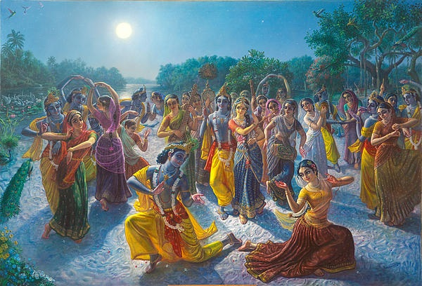

Slide 25
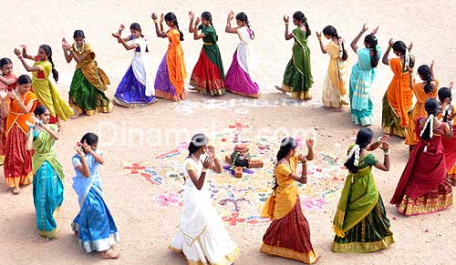

Slide 26
F-06
Kummiyadippom Thozhiare - Nam
Govindan Naamangal Paadiduvom
Gokula Naathan Nam Gopaalan
Kaarmuhil VarNanai Paadiduvom ...(Kummi)
Aayar paadiyil Arputham Seitha
Maayanai Naamume Paadiduvom
Maa Yashoda Madiyil Thavazhntha
Seyanai Yenrume Paadiduvom ..(Kummi)
Sundara Baalanaam Nanda Gopaal Nam
Bhandhamadi Avan Thanjamadi
Indira Lokamum Vendaam Intha
Thanthira Kaaran Thaan Sonthamadi ..(Kummi)
Manmata Mohana Baalanadi Avan
Mantha Haasa Madhu-Soodanadi
Mangalam Pongave Paadiye Manam
Pongave Kummi Aadiduvom .. (Kummi)
Thannanan Thannaa Thannaana - thana
Thannanan Thannaa Thannaana
Thannanan Thannaa Thannaana
Thannanan Thannaa Thannaana

Slide 27
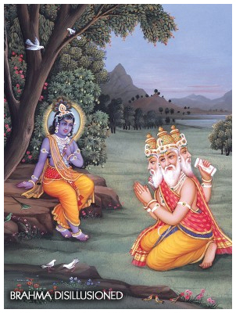
govindam ādi-puruṣaḿ tam ahaḿ bhajāmi
I worship Govinda, the primeval Lord, the first progenitor ...

Slide 28
Slides Video
Brahma Samhita

Slide 29
QUESTIONS?

Slide 30
Thus ends the Episode:
Brahma Samhita – 01 (Introduction)

